Slide 1
Skin biopsy interpretation Histological features of skin diseases
Prof. Janaki Hewavisenthi
Senior Professor of Pathology
25th Original

Slide 2
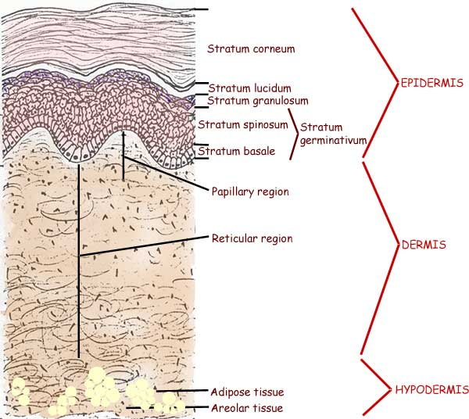
Structure of normal skin

Slide 3
Structure of the skin
Epidermis
Keratinocytes
Basal cells - stratum germinativum
Prickle / spinous cells - Stratum spinosum
Granular cells - Stratum granulosum
Cornified cells - Stratum corneum
Melanocytes
Langerhan cells
Merkel cells
Dermis
Composed of blood vessels lymphatics nerves mucopolysaccaride ground substances and epidermal appendages

Slide 4
Structure of the skin
Epidermal appendages / skin adenexae
Sebaceous glands
Hair follicles
Eccrine glands
Apocrine glands

Slide 5
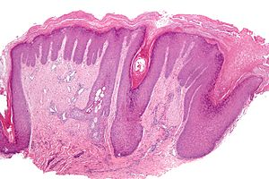
Terminology in skin biopsy reports
HYPERKERATOSIS
Increase in the stratum corneum leading to thickening of the skin

Slide 6
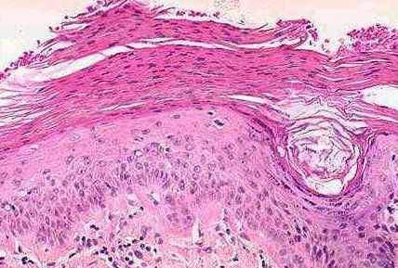
Parakeratosis
Thickening of the stratum corneum with preservation of the nuclei.
This occurs when the proliferation and maturation of the keratinocytes are abnormally rapid - Psoriasis

Slide 7
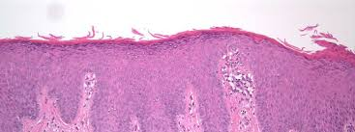
Acanthosis
Acanthosis
Increase in the spinosum or increase in in all layers of the epidermis

Slide 8
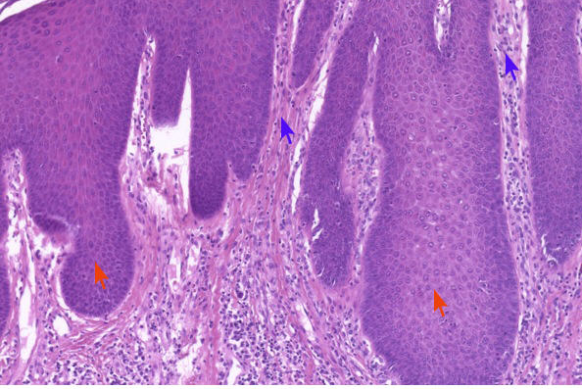
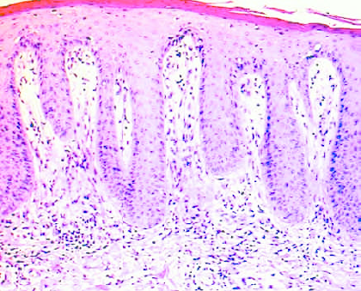
Acanthosis vs Psoriasiform hyperplasia

Slide 9
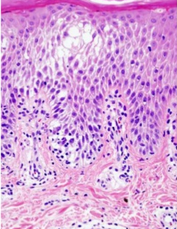
Spongiosis
This is oedema between epidermal keratinocytes which may progress to bullous or vesicle formation
Spongiotic dermatitis
Epidermal hyperplasia
(Acanthosis)
Spongiosis

Slide 10
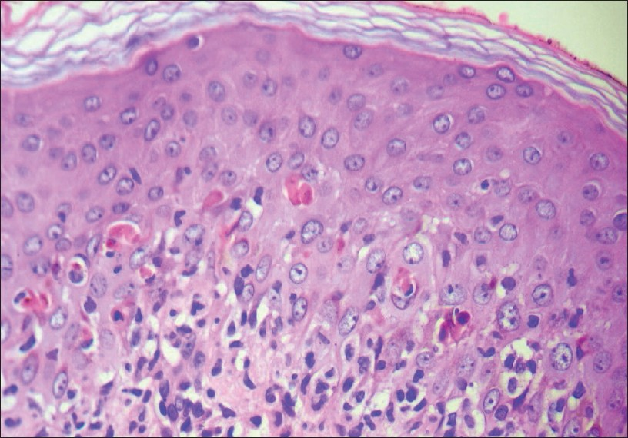
Apoptotic keratinocytes
Erythema multiforme
Ctyotoxic drug eruptions

Slide 11
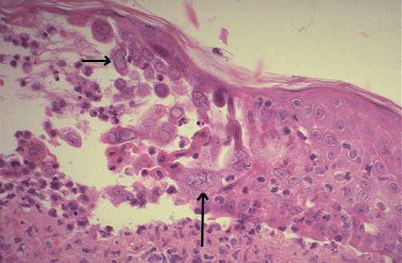
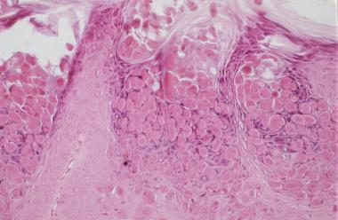
Inclusions within keratinocytes
Intranuclear viral inclusions
Cytoplasmic eosinophilic inclusions of Molluscum contagiosum

Slide 12
Papillomatosis
Generally a combination of both acanthosis and hyperkeratosis resulting a polypoid or papillary architecture
Causes – Seborrheic keratosis
Viral infections – Verruca vulgaris
Squamous cell papilloma

Slide 13
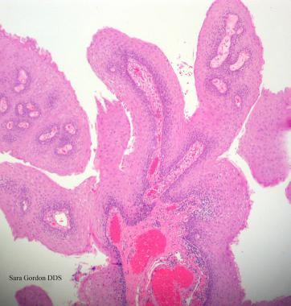
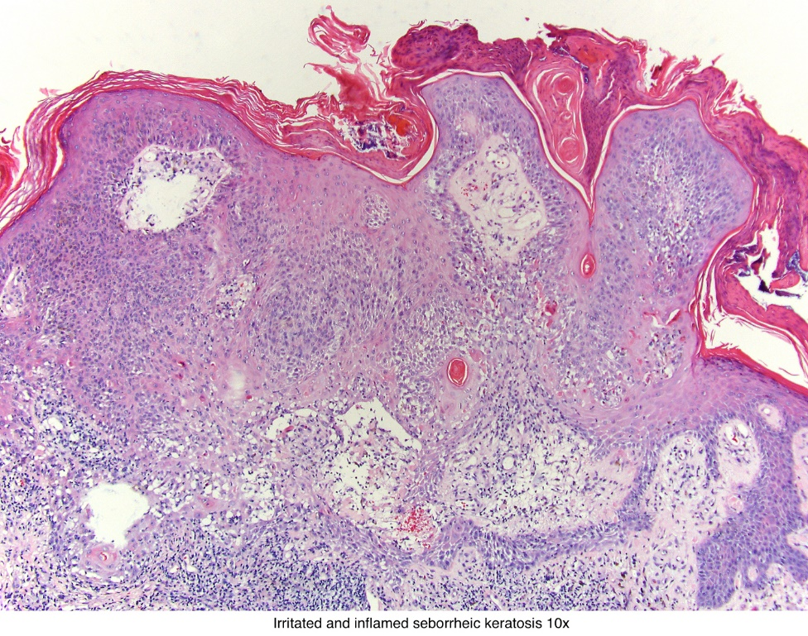
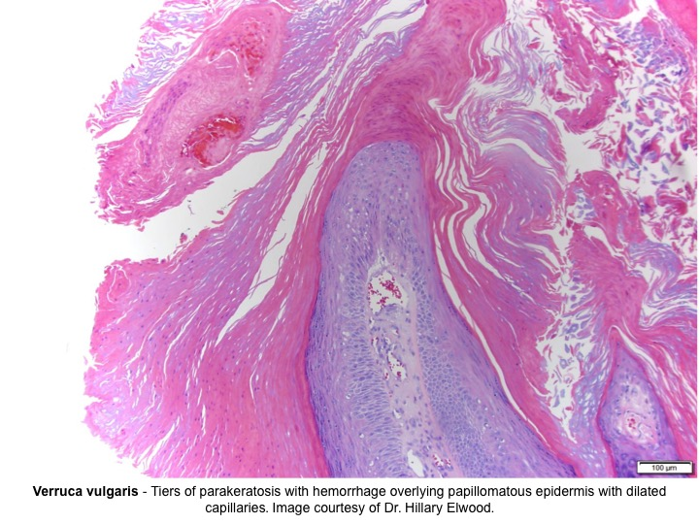
Papillomatosis
Often a combination of acanthosis and hyperkeratosis
Causes – Verruca vulgaris (Viral wart)
Seborrheic keratosis

Slide 14
Hypergranulosis and hypogranulosis
Affects the granular layer (stratum granulosum)
Hypergranulosis – thickening of the granular cell layer
Hypogranulosis – thinning or absence of the granular cell layer

Slide 15
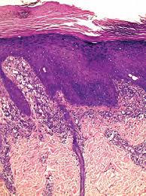
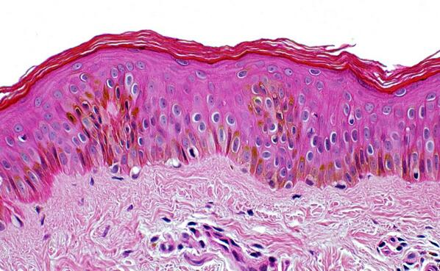
Hypergranulosis and hypogranulosis

Slide 16
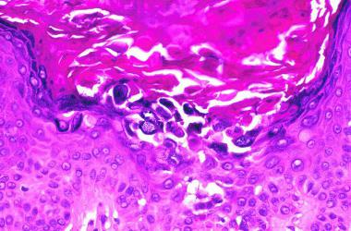
Dyskeratosis – affecting granular layer
Dyskeratosis is abnormal keratinization occurring prematurely within individual cells or groups of cells below the stratum granulosum.
ACANTHOLYTIC DYSKERATOSIS

Slide 17
Basal layer
Basal cell degeneration and Civatte body formation
Basal cell degeneration is vacular or hydropic change in the cells of the basal layer
Civatte body or Colloid body formation is often associated

Slide 18
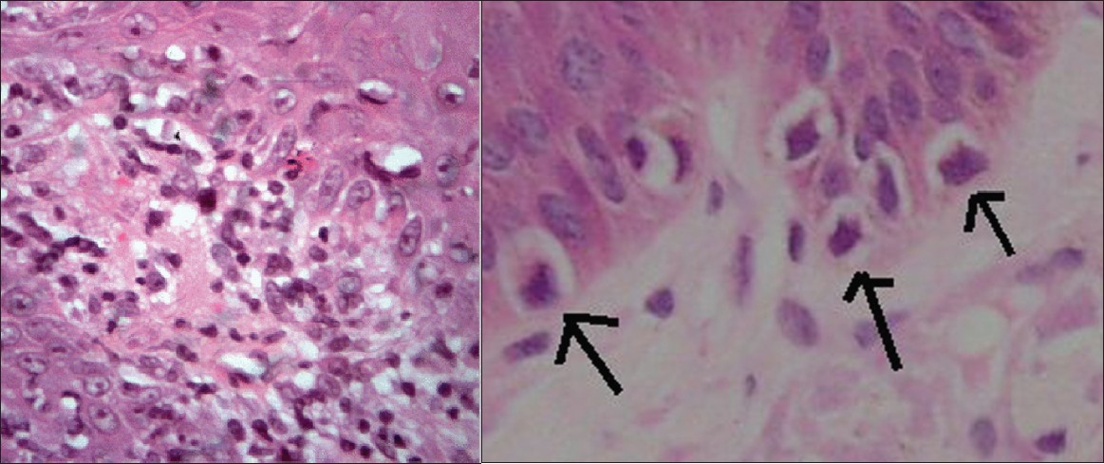
Basal cell degeneration
Often associated with an upper dermal inflammation termed the lichenoid reaction or interface reaction pattern

Slide 19
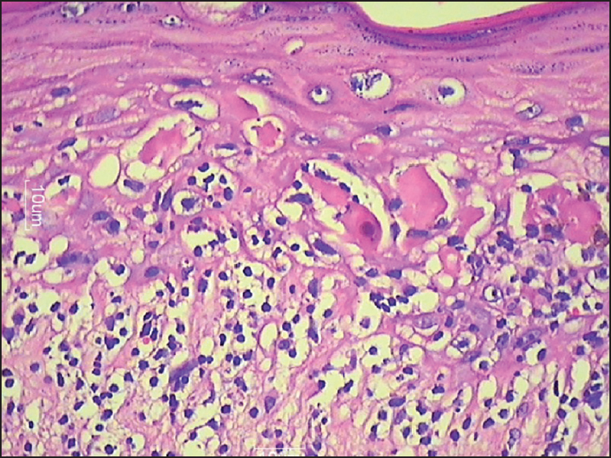
Civatte body formation
Necrotic keratinocytes at the interface between epidermis and dermis
Causes :
Lichen planus
GVHD
Lupus erythematosus
Drug reactions

Slide 20
Blister formation
Blister formation mechanism | Diseases
Spongiosis (Accumulation of fluid round keratinocytes) | Eczematous dermatitis Early pemphigus
Acantholysis (loss of keratinocyte cell contact) | Peimphgus Dariers disease Hailey – Hailey disease
Reticular degeneration (intracellular oedema of keratinocytes | Viral infections Eczematous dermatitis (Late stages)
Cytolysis (lysis or rupture of keratinocytes) | Epidermolytic hyperkeratosis Erythema multiforme Irritant dermatitis
Basement membrane zone disruption or destruction | Bullous pemphigoid Linear IgA dermatosis Dermatitis herpatiformis Edpidermolysis bullosa

Slide 21
Blister formation – classification based on the plane of formation
Plane of bulla / vesicle formation | Disease
1. INTRA- EPIDERMAL 1.1 Subcorneal / granular | Pemphigus foliaceous and variant Staphylococcal scalded syndrome Bullous impetigo Subcorneal pustular dermatosis
1.2 Suprabasal | Pemphigus vulgaris Dariers disease
2. SUBEPIDERMAL 2.1 Basal keratinocyte damage | Erythema multiforme Herpes gestationis
2.2 Epidermal basement zone destruction | Bullous pemphigoid Dermatitis herpatiformis Systemic lupus erythematosus

Slide 22
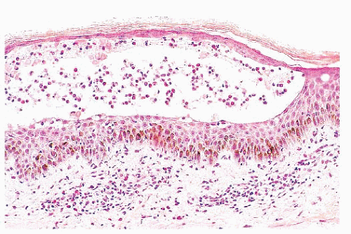
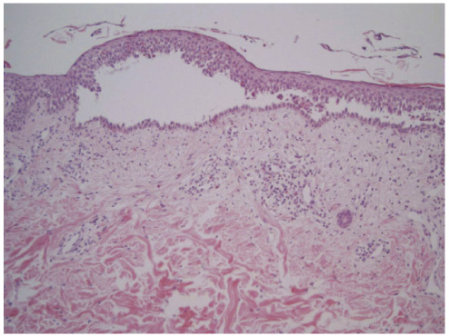
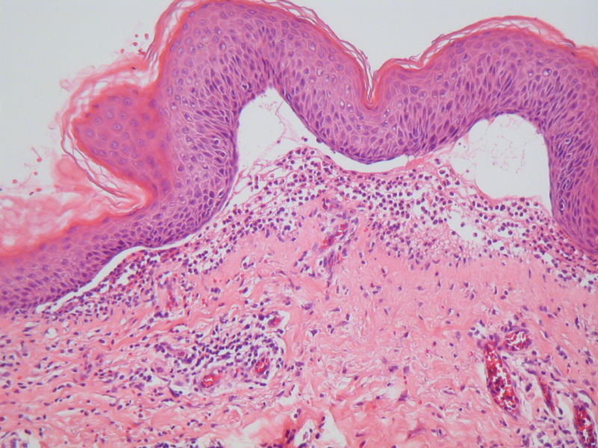
How would you describe these bullous lesions ?

Slide 23
Dermal inflammatory cell infiltrates
Eosinophils
Bullous pemphigoid
Pemphigus vulgaris
Arthropod bite
Drug reactions
Neutrophils
Urticaria
Dermatitis herpatiformis
Lupus erythematosus
Neutrophilic dermatosus
Plasma cells
Syphilis
Folliculitis
Mast cells
Mastocytosis

Slide 24
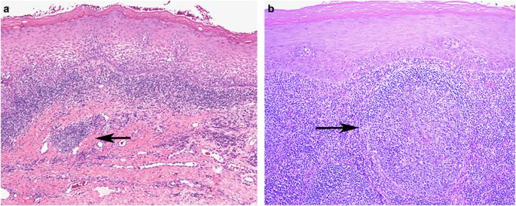
Lichenoid cell infiltrates (interface reaction)

Slide 25
Dermis – Dermal matrix disorders
Collagen increased – Scleroderma / Morphoea
Collagen decreased – Atrophoderma
Elastin altered – Pseudoxanthoma elasticum
Elastin reduced – Cutis laxa
Deposition of material
Normal matrix content increased – Focal dermal mucinosis
Deposition of amyloid
Deposition of uric acid crystals in Gout
Deposition Calcium pyrophosphate dihydrate crystal in pseudogout

Slide 26
Dermal infiltrates
Histiocytes
Can collect to form granuloma or in conditions such as
Leishmaniasis
Lepromatous leprosy
Melanophages
Often denote melanin incontinence due to the basal cell degeneration and damage

Slide 27
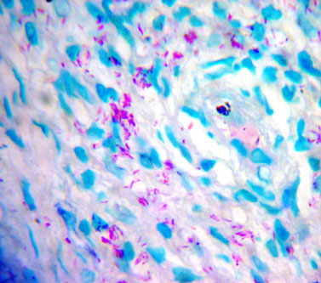
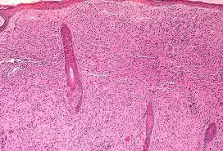
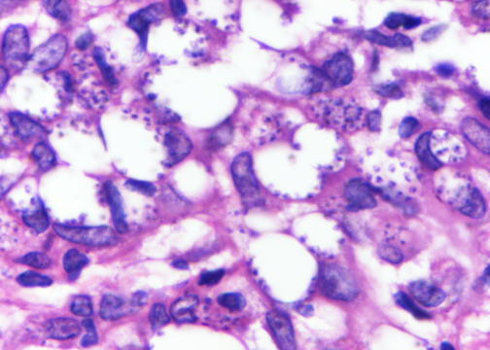
Histiocytic infiltrates

Slide 28
Granulomatous dermatitis
Infectious granulomas
Tuberculosis
Leprosy (Tuberculoid type)
Fungi
Leishmaniasis (Late stages)
Non infectious granulomas
Granuloma annulare
Necrobiosis lipoidica
Rheumatoid nodules
Sarcoidosis
Foreign body reactions
Silican, talc, Aluminium, Zinc, Tattoo, Berylliosis etc.

Slide 29
Dermal vascular diseases - Evaluation
Size of the vessel involved – large, medium, small
Composition of the cell infiltrate – neutrophil, eosinophil, lymphocytic, histiocytic.
Evaluation for infection
Serological and immunopathological evaluation
ANCA, ANA, Rheumatoid factor, Cryoglobulins
Clinical context
Cutaneous involvement only.
Systemic disease.

Slide 30
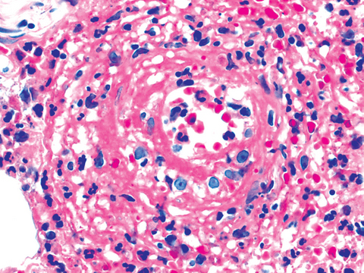
Vasculitis
Criteria for diagnosis of vasculitis
- Endothelial cell swelling
- Red cell extravasation
- Inflammatory infiltrate
around blood vessels
- Fibrinoid material deposited
in the wall of the vessel.

Slide 31
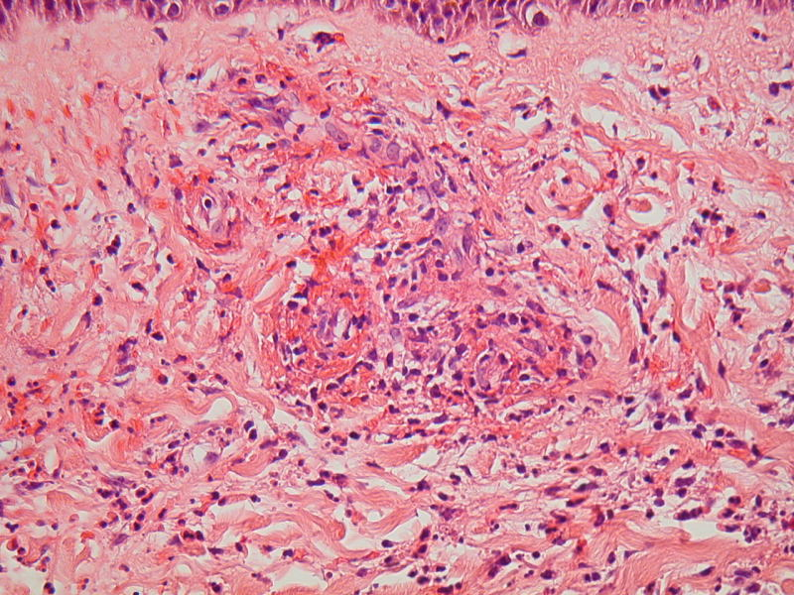
Leukocytoclastic vasculitis
Infectious – Bacterial, Fungal, Rickettsial, Viral
Immunological injury
HSP
Urticarial vasculitis
Cryoglobulinaemia
Connective tissue disease
Autoimmune disease (HBV, HCV, Streptococcal
Drugs
Paraneoplastic syndromes
Antineutrophilic antibody associated
Wegeners granulomatosis
Churg-Strauss Syndrome
Microscopic polyangitis
Unknown
Polyarteritis nodosa

Slide 32
Panniculitis
Inflammation of the subcutaneous fat.
Septal lobular or mixed patterns
Types
Erythema induratum
Lupus panniculitis
Eosinophilic panniculitis
Cytophagic histiocytic panniculitis
Weber Christian disease
Erythema nodsum
Subcutaneous T cell lymphoma

Slide 33
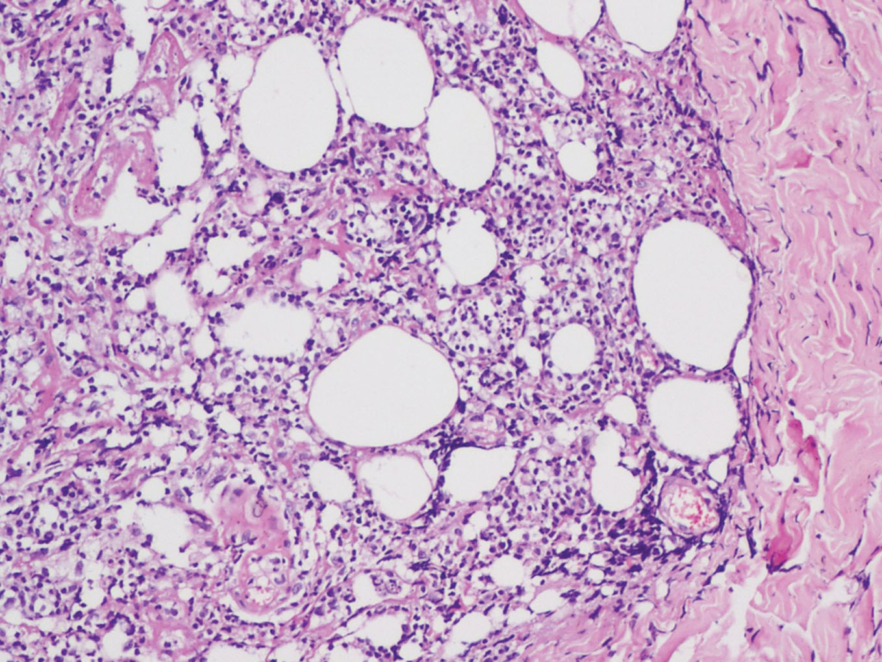
Panniculitis

Slide 34
Reaction patterns in the skin
Spongiotic
Lichenoid / interface
Psorisiform
Vesicullobullous
Granulomatous
Vasculopathic

Slide 35
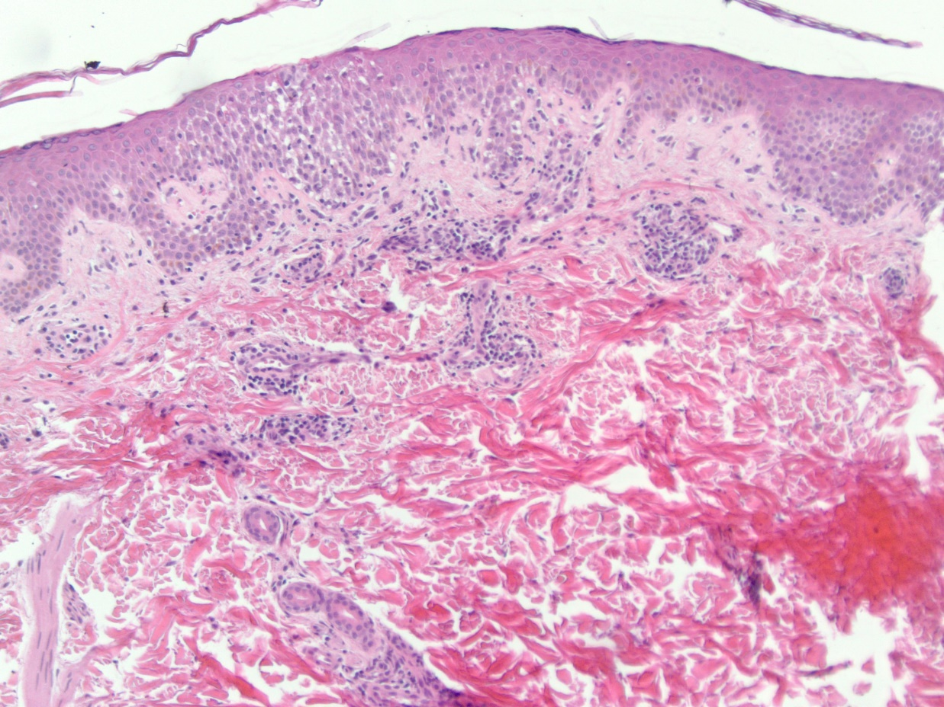
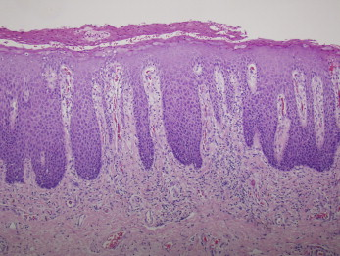
What is the reaction pattern in these skin biopsies ?

Slide 36
Skin biopsy
Biopsy technique
Punch biopsy not shave biopsy for dermatitis
Wedge or incisional biopsy with scalpel for ruling out panniculitis
Vesicles or bulla should be removed with scalpel to avoid shearing off of the lesion.
Biopsy sites to be avoided
Acral
Elbow
Excoriated lesions
Treated lesions
Accompanied with a clear history and a differential diagnosis
Site of biopsy
Type of skin lesion – Papular macular etc.
Distribution of the lesions
Differential diagnosis

Slide 37
